Slide 1

Future:now
The emerging technology trends

Slide 2
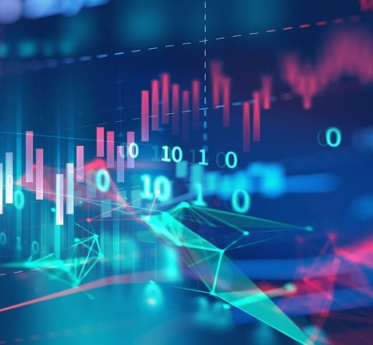
Our challenge
With technology playing an increasing role within the finance sector we have been approached by a client who wants to understand if new technology based tools (and currencies) are aiding investors to deliver stronger results, or whether the traditional investment methods are standing the test of time.

Slide 3
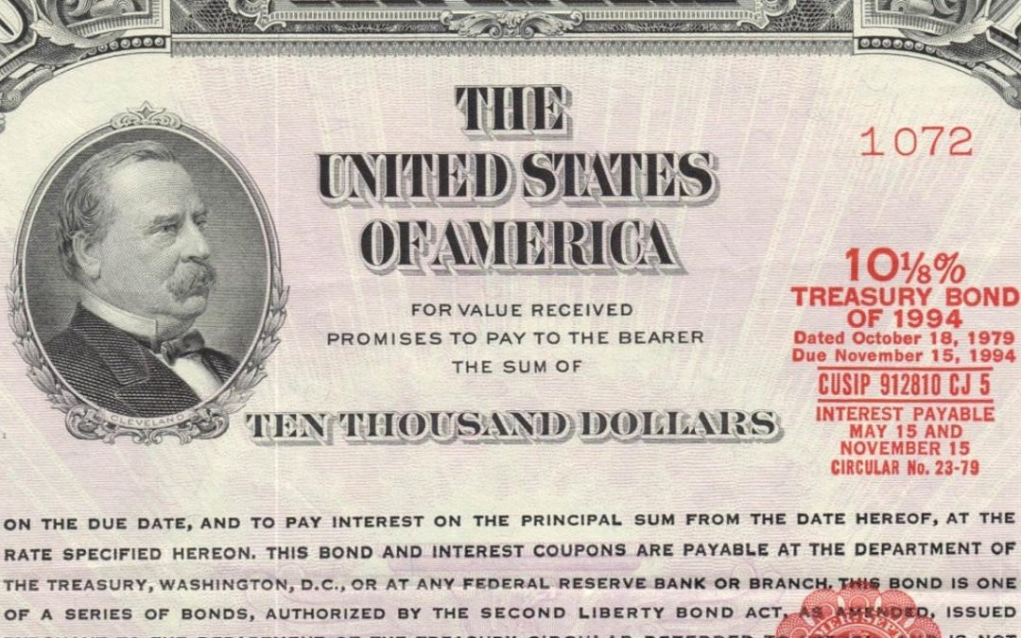



Approach
We will answer this question through running analysis across 3 portfolios, then compiling the results in a user friendly dashboard that will allow our client the ability to quickly analyse the differing investment levels strategies.
<Need to add a few words on algorithm>
We will use 4 asset classes for our analysis:
US Treasury 5 Year
S&P 500
Gold & Silver
Cryptocurrencies
Commodities: Gold & Silver – 50/50 weighting
Crypto: BTC 81.3% LTC 1.4% XRP 1.2% ETH 16.1%

Slide 4
3 Strategies to analyse
Low Risk
Medium Risk
High Risk
More Crypto/ Less Commodities/ Less Bonds
Splits
Commodities: Gold & Silver – 50/50 weighting
Crypto: BTC 81.3% LTC 1.4% XRP 1.2% ETH 16.1%
Shares: S&P 500
Bonds: US Treasury 5 Year

Slide 5

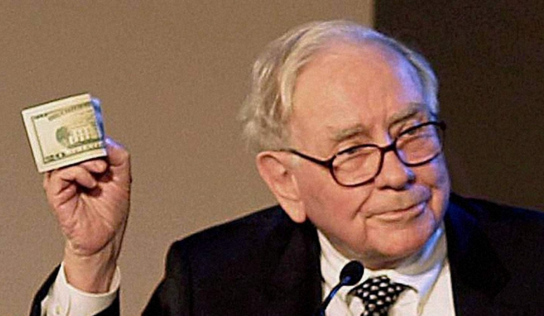

Top 3 Key questions
Are crypto currencies the volatile investment they’re made out to be, or can they actually compliment an investment strategy?
Was Warren Buffet correct in thinking that gold doesn’t fit with a strategy of value investing?
Should trading algorithms be considered as a way to manage portfolios or is it too risky?

Slide 6
Trading Algorithms - explanation

Slide 7
The dashboard

Slide 10
If only We had more time…
We would:
Run a larger number of different strategies to give a more robust result
Work on the interface/dashboard to improve usability and appeal
Allow user input to enter investment amounts and show $ returns
Go one level deeper – splits within the asset types

Slide 11
Thank-You & Questions

Slide 12
Story Board- (not for presentation)
Recent talk of cryptos and algorithms have got many traditional investment companies in a spin!
Our client has sought our advice as to if cryptocurrencies and trading algorithms should be considered in todays investment strategies
We will run 3 different trading strategies to show the client the effects of integrating new technologies in their investment strategies

